Slide 1

TO BE SURPRISED ABOUT OUR FIRST OFFICE,
by Martina Rivero

Slide 2

METHODOLOGY
Benchmarking of companies related to tech.
Total money raised > $ 1M.

Slide 3
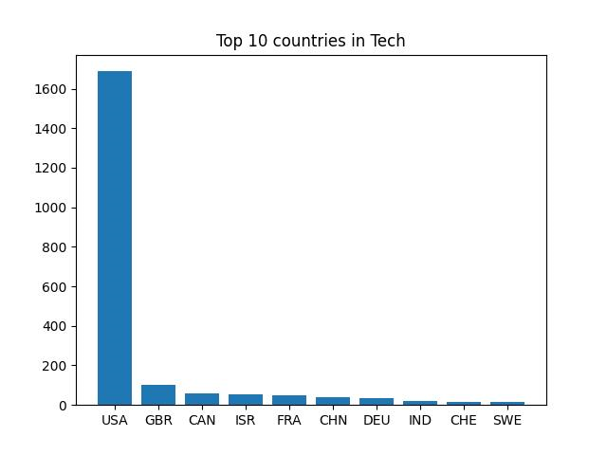

Slide 4
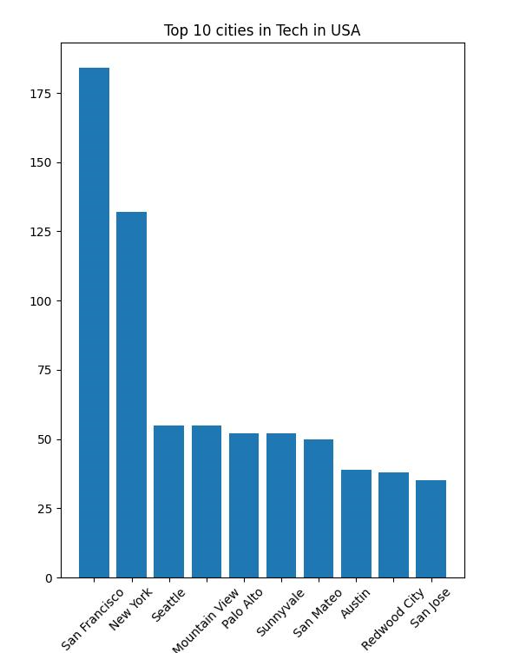

Slide 5
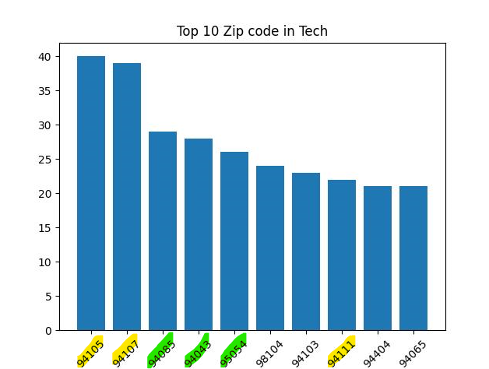
SAN FRANCISCO
SUNNYVALE and surroundings

Slide 6
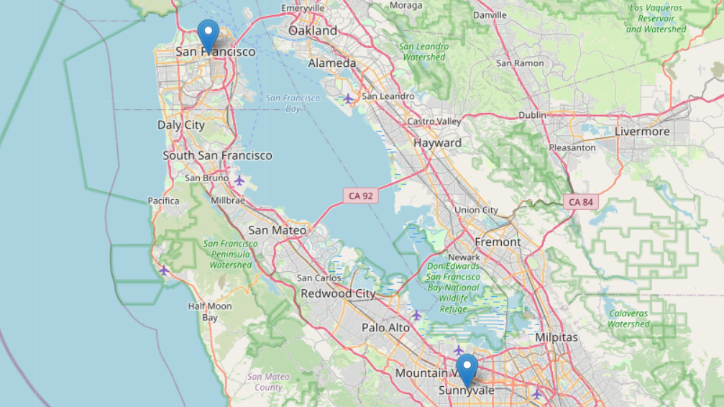

Slide 7
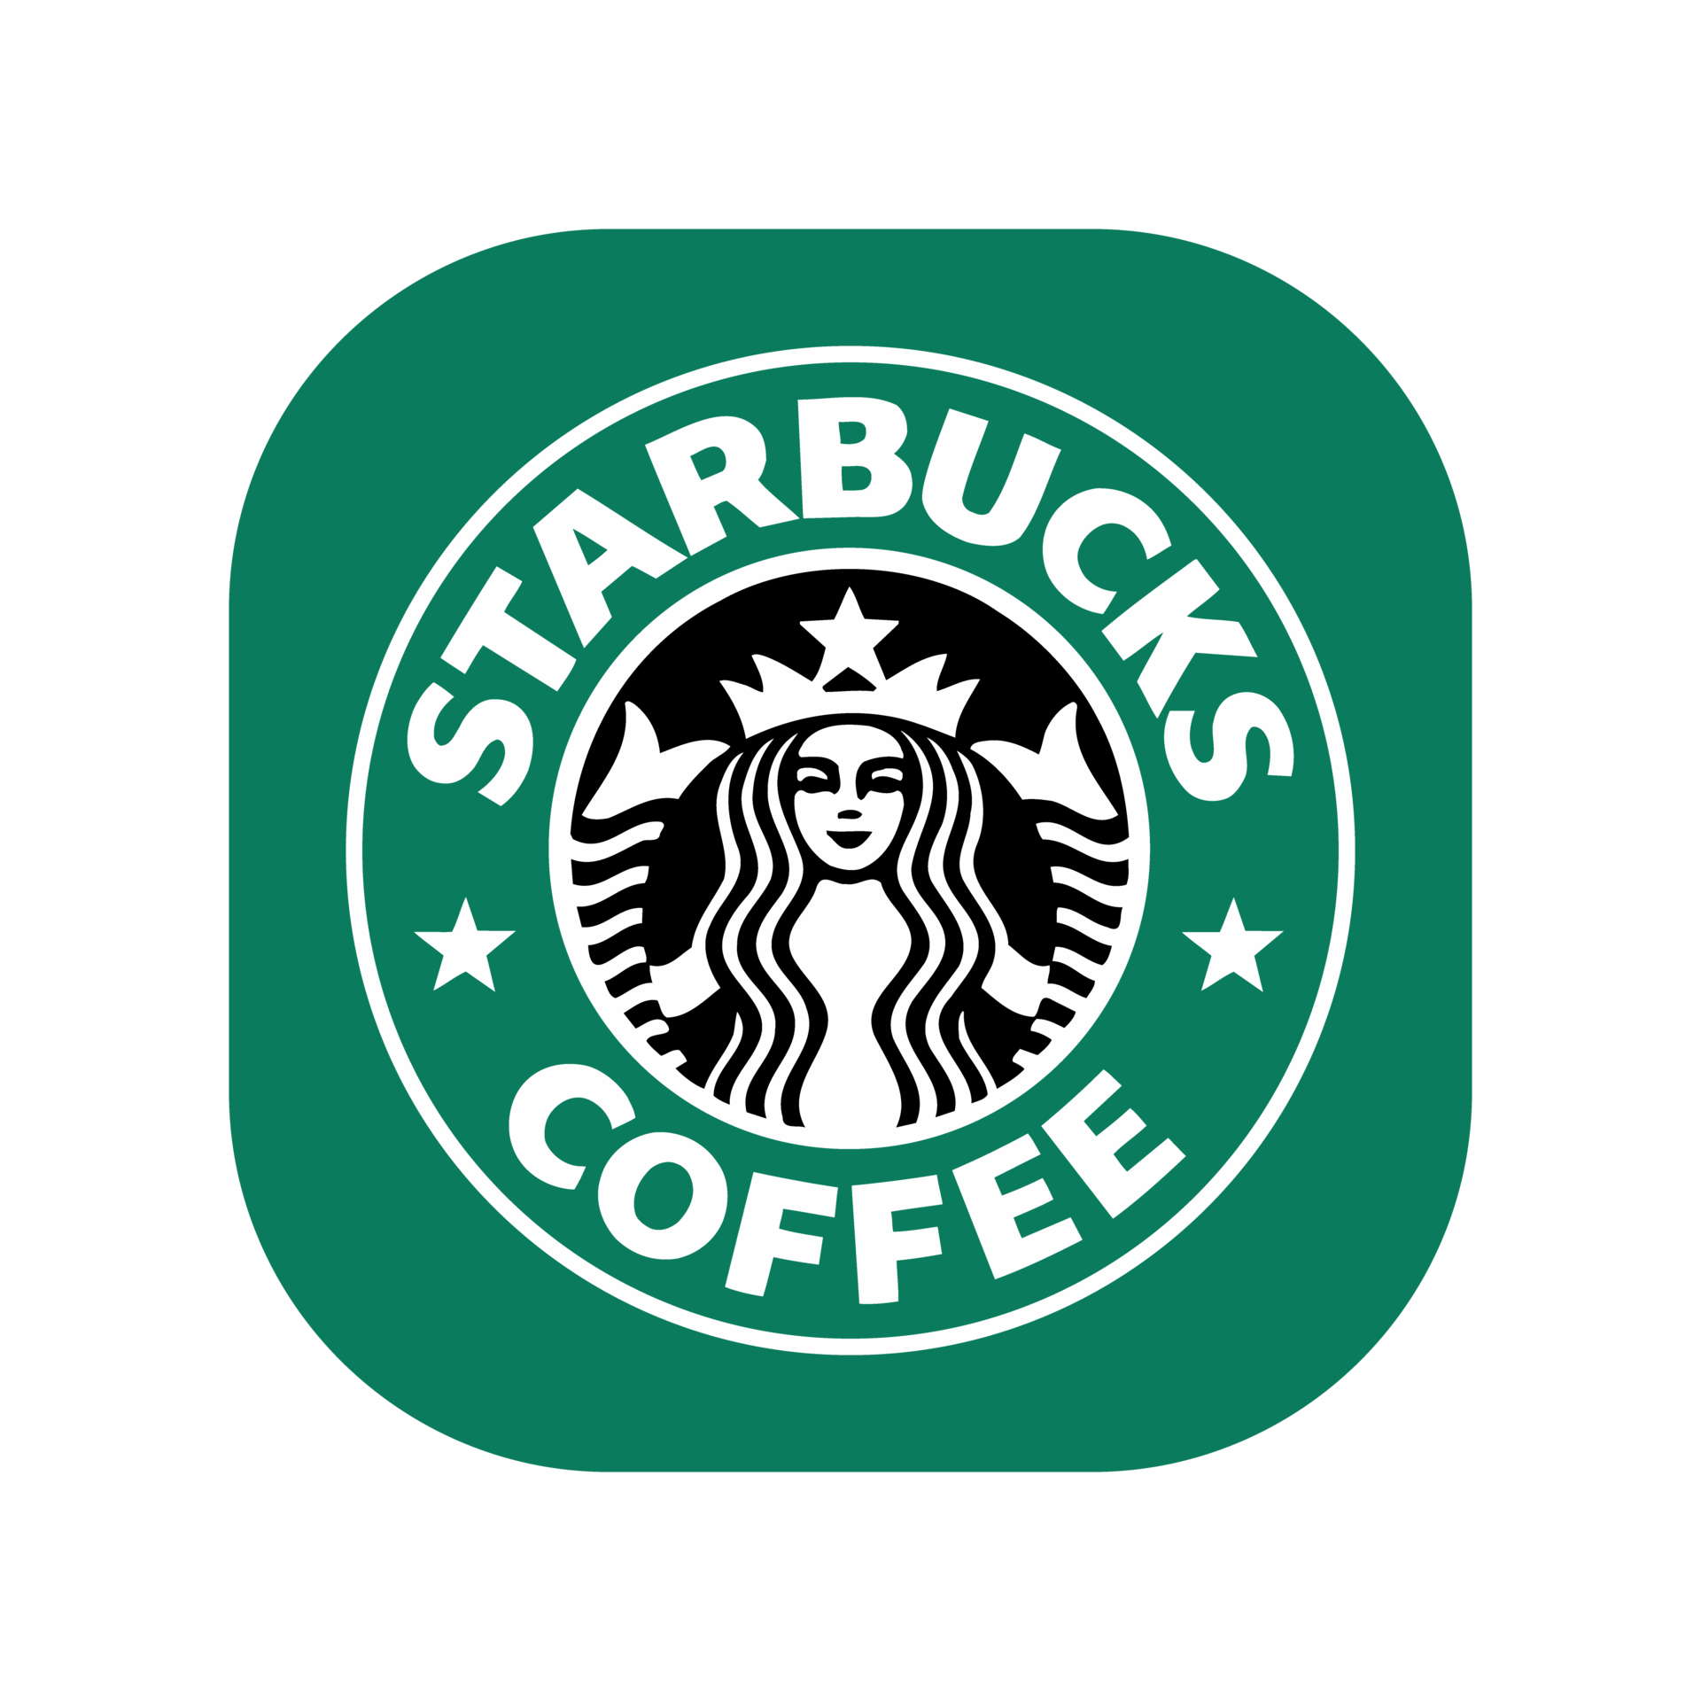


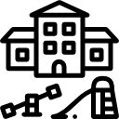
CRITERIA
Vegan restaurants
Airport
Preschools
Starbucks

Slide 8
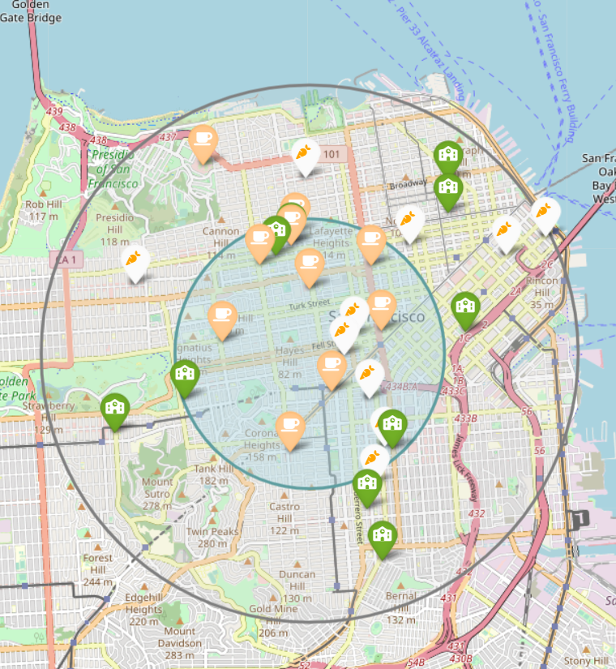
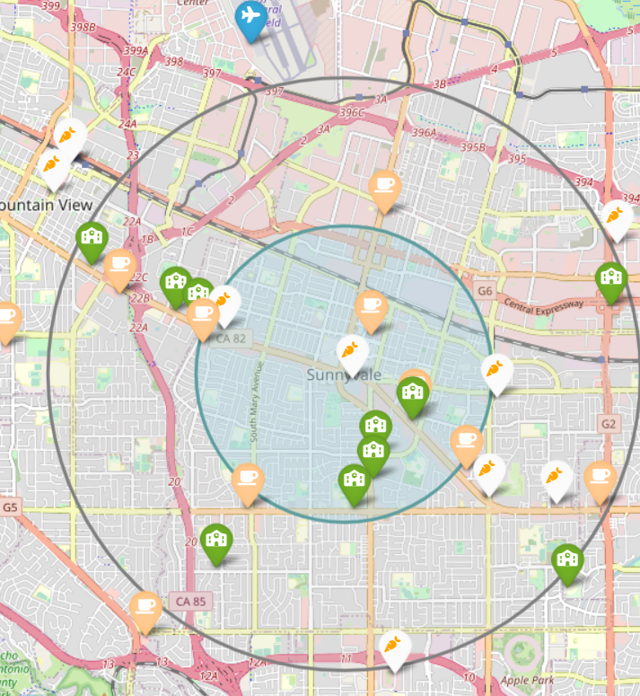
SAN FRANCISCO
SUNNYVALE

Slide 9

SAN FRANCISCO VS SUNNYVALE
+ vegan restaurants.
+ Starbucks.
+ tech companies.
+ preschools.
Closer airport.
Lower cost of living.
So... who is the winner?

Slide 10

SUNNYVALE!

